Slide 1

Collaborative Filtering
Grid mode active: Navigate to detail slides by pressing 'H'
For fun and profit
9/23/2018

Slide 2
Agenda
What is CF?
How is CF done?
What are the use cases for CF and why?
Our model and validation
Questions
1
2
3
4
5

Slide 3
What is collaborative filtering?
Collaborative Filtering is an advanced method to provide personal recommendations to customers
Films
Method identifies latent customer characteristics and calculates affinity for products and content
Users
Collaborative Filtering used in many applications such as Netflix, Amazon, for its predictive power and scalability

Slide 4
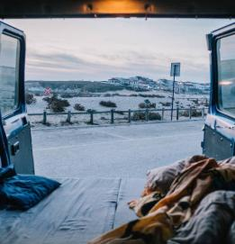
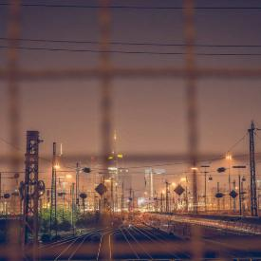

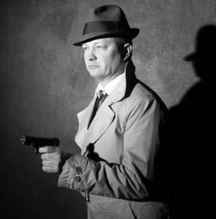

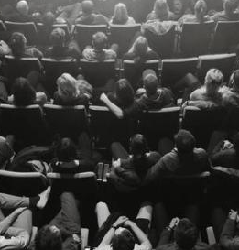


Transaction data used to produce a matrix of users and film interactions
Collaborative Filtering maps users and films to small # of latent factors
User purchases of movies
Movies
Serious
Amadeus
Braveheart
 | 1
 | 1
 |  | 1
 |  |  |  |  | 1
 |  | 1 | 1
 |  |  |  |  |  | 1
1
The Color Purple
Lethal Weapon
Geared towards females
Sense and Sensibility
Ocean’s 11
Geared towards males
Users
Dave
The Lion King
Dumb and Dumber
The Princess Diaries
Independence Day
Gus
Escapist
Can be used to identify users with similar likes, films with similar fans
Calculate of user-item affinities using these latent factors of users & films

Slide 5
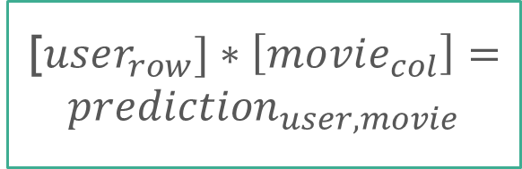
Predictions for user-film affinity are computed using these latent variables, identifying the high scoring films to recommend
User hidden factors
Movie hidden factors
User purchases of movies
Movies
Latent Factors
u | u | u
 |  |  | ?
Movies
 |  |  | m
 |  |  | m
 |  |  | m
Users
.
Latent Factors
Users
Users
H
[$user_{row}]∗\left[movie_{col}\right]=prediction_{user, movie}$
W
User Affinity for item predicted by latent variables (right)

Slide 6
Recommenders can be utilized beyond personalization, and support operational planning and forecasting
Personalization
Improve user engagement with promotions
Increase # of visits to cinema, with relevant films
Operations
Improves decisions for which films to show, or # screens
Drives sales and customer interest with more relevant films
Forecasting
Film affinity data provides additional signal to improve predictions:
Film attendance
Ticket Revenue

Slide 7
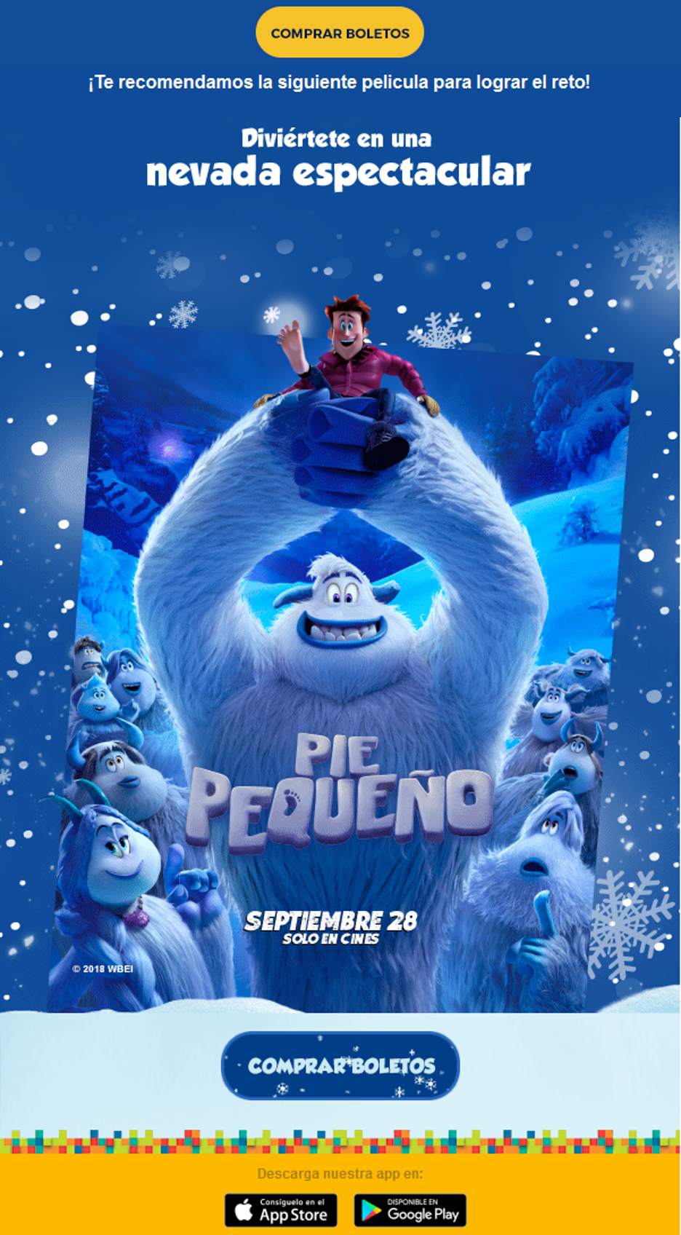
Current Use: Improve content recommendation for Frequency of visits in pilot campaign
Use collaborative filtering to generate material specific to user, out of roster of current films
Personalized content film has higher likelihood of capturing interest

Slide 8
Model Validation

Slide 9
Model Validation approach involves 'hides' information from our model to test it's performance
Make two matrices of users' film purchases
Fit model with using censored dataset
Evaluate performance on entire dataset
First: entire matrix of user-film purchases
Second: Partially censored matrix
Subset of user-item purchases hidden.
Build Collaborative Filtering model with 'censored' matrix.
Answers are 'withheld' from the model so we can properly quiz it
Calculate predictions with latent factors.
Validate by comparing predictions to censored purchase behavior

Slide 10
Retrospective Analysis Results: Modified Top-3 Recall. If model provides 3 recommendations, what percentage chance is any recommendation relevant?
Introduced predictive models
% of recommendations that identify a film seen by a user from 11 Mar - 30 Mar, 2018
+50%
+33%
+9%
70%
61%
37%
20%
Random(3 of 15) R
Popular film model
Peeking model
Recommender Engine
Recommendation Method
Note: Similar time window constraints to previous slide, but providing recommendations out of 15 films instead of 24
# of Films Recommended/Evaluated: (24-> 15)

Slide 11
Recommender captures a larger variety of films tailored to the individual, outperforming controls overall
Percent of viewers who saw film and were correctly recommended it, by model (25000 Users)
Recommender captures variety at expense of ‘obvious’ choices
Total Sample
Peeking
44
44
Recommender
Recommender aims to ID relevant films unnoticed to user, over those likely to be seen regardless.
Next steps: A hybrid model, supplying both ‘popular’ and a novel titles, may provide best results
28
28
26
23
20
18
15
PANTERA N
LA FORMA
TOMB RAID
OPERACION
LA BODA D
LA MALDIC
COMPLICES
Most popular to least popular titles, in observation period
Note: Sum of percentage will exceed 100%; Some users see multiple films in March.
*May provide more lift than films a people would've seen. Top 7 films of 15 displayed.

Slide 12
Other metrics may be more useful depending on the use-case
Recall @ Top-K: (Current): What percentage of relevant films are recommended by model?
Precision @ Top-K: What percentage of recommendations are relevant to the user?
Other metrics: interesting to recommenders less applicable to film but more applicable to a menu usecase:
Mean Average Precision
Discounted Net Cumulative Gain
Applicable Query: ‘Metrics for Ranking’, ‘Rankings for Information Retrieval’ https://en.wikipedia.org/wiki/Evaluation_measures_(information_retrieval)

Slide 13
Current Snapshot and Next Steps

Slide 14
Current Modules can likely be used for transitional use-cases before new architecture is implemented.
SQL Database Interactions
Python-Side data munging (Numpy)
Model Fitting and Evaluation
Series of methods to interact with transaction database on redshift.
Converts long-shaped tables into sparse matrices, ready for training and manipulation.
Trains collaborative filtering model using Alternating Least Squares
Downside: Cannot recommend behavior of new films due to ‘Cold Start’ problem.

Slide 15
3 Broad Areas of Changes Affect how this model is to be used and deployed
Data Storage and Pipelines
Model Fitting and Analysis
Other Use-Cases and Re-purposing
Move to Hadoop and Spark will introduce changes to how data interacted with.
Code changes:
SQL interaction steps adapted to HIVE.
Numpy manipulation on single node converted to Spark matrices (or alt.)
Use of out of the box spark libraries where possible.
Code changes:
Use of a library like MLLIB that can handle collaborative Filtering
This model may be a strong fit for concession product affinities.
Code changes:
Content filtering pipeline, to recommend new films
Menu Pipeline

Slide 16
Questions?

